Slide 1
Global Office 365 Bootcamp – København, Danmark
Anders Dissing
Microsoft Office Servers and Services MVP, Formand for SPBG

Slide 2
Agenda
Time | Topic / Activity | Speaker
9:00 | Velkomst | Anders
9:30 | Graph Intro | Bernd
10:15 | Pause
10:30 | Graph Auth og Groups inkl hands-on | Bernd
12:00 | Frokost
13:00 | Team Apps fundamentals | Anders
13:45 | Team app fundamentals hands-on | Anders
14:30 | Pause med Survey og SWAG
15:00 | Teams app advanced | Anders
16:15 | Pause
16:30 | Teams advanced hands-on | Anders
17:30 | Afslutning

Slide 3
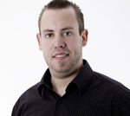
Speaker introduction - Anders
Anders Dissing – MVP and SPBG chairman https://www.linkedin.com/in/andersdissing, @andersdissing
Anders is a SharePoint architect and lead developer. He has worked extensively with SharePoint (2013/2010/2007/2003) from different angles such as development, architecture, consulting, management and upgrading.
Back in 2011, Anders was awarded with his first Microsoft MVP title.
In 2008, Anders established the Danish SharePoint user group. Since then, he has organized many user group events, one SharePoint Saturdays and has participated as a speaker in many of these events.

Slide 4
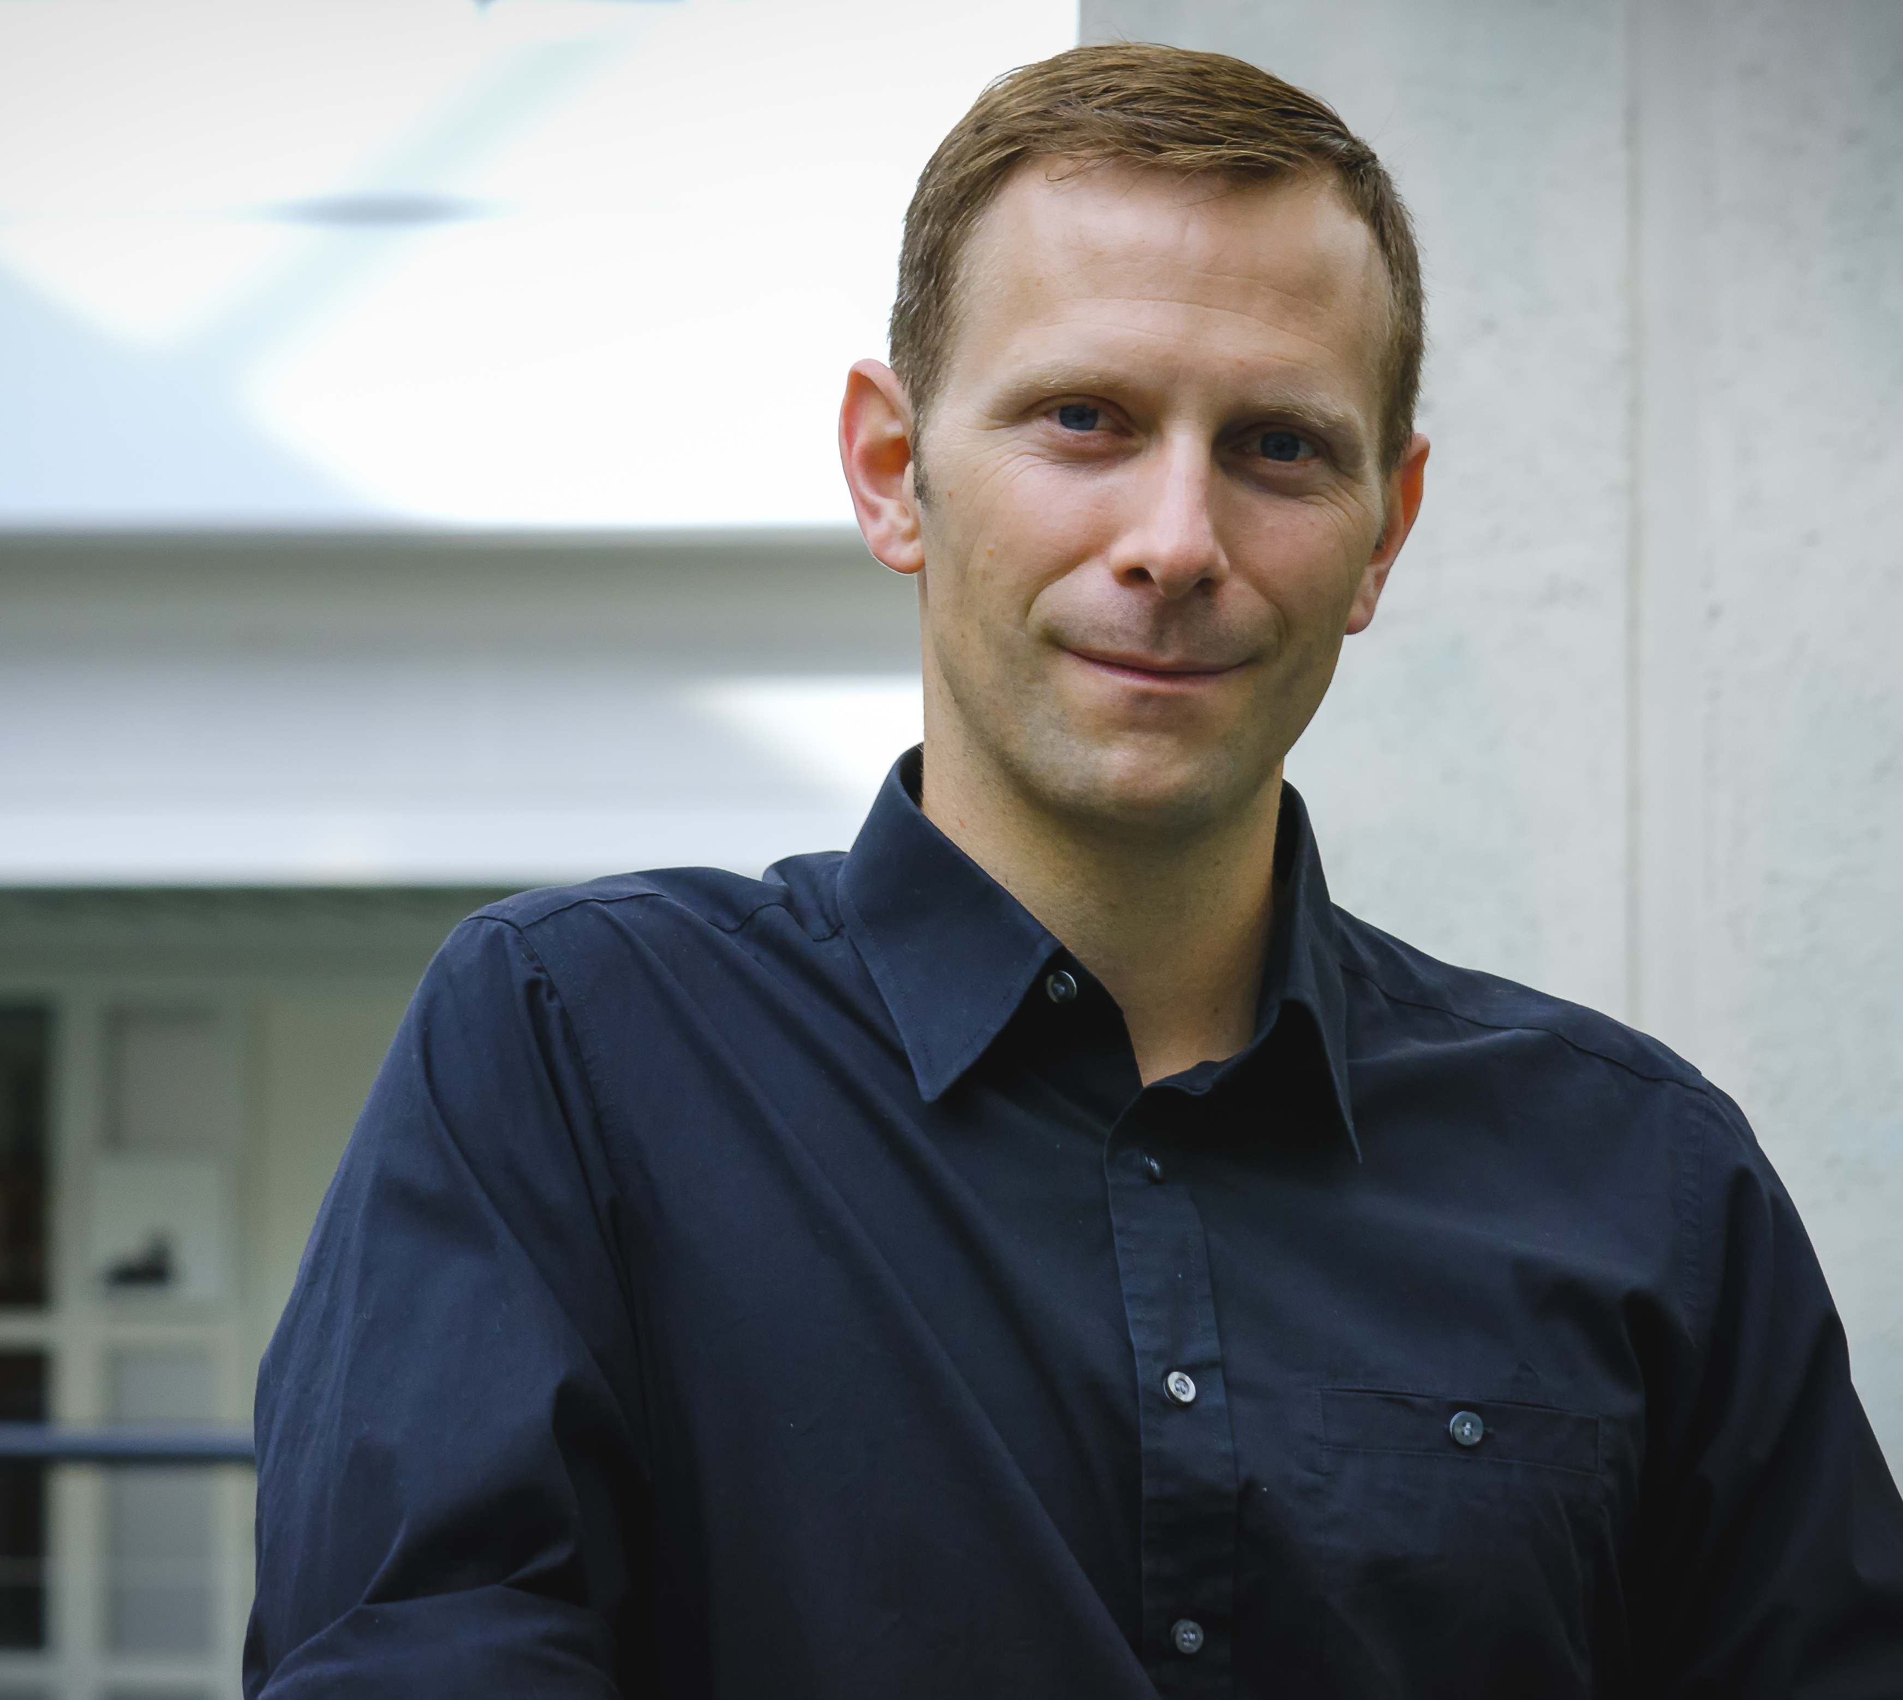

Speaker introduction - Bernd
Bernd Rickenberg – CTO @ Pointwork https://www.linkedin.com/in/rickenberg, @berndrickenberg
Bernd is a Microsoft certified developer and architect on the .NET, SharePoint and Azure platforms. Bernd has spoken at the Microsoft Campus Days, SharePoint Saturday in Stockholm and local community events.
He is working as CTO and developer at Pointwork in Copenhagen for local companies such as Novozymes, Novo Nordisk, COWI and MAN Diesel & Turbo.
Pointwork is a Copenhagen based consultancy company specialized in developing SharePoint and Office 365 based solutions.

Slide 5

Tak til Pointwork
Tak til Pointwork for at hjælp med hands-on labs og andre spørgsmål som må opstå under vejs på dagen

Slide 6
Telefon, kaffe og wc

Slide 7
Dev Tenants
Dev Tenants med Content packs: Commercial og Dev Tenant
Log ind https://www.office.com/

Slide 8
Andre møder
Endnu ikke planlagt møde omkring GDPR og Office 365
SharePoint dinner

Slide 9

Call to action
(Recommendation to Bootcamp organizers and speakers: This slide can be used at the end of the Bootcamp to have attendees to fill online feedback form and recommendation for their ongoing learning and app development on Office 365 platform. Please keep the first three bullet points, you can update the last bullet point to be the user group or community that you are leading that you’d like attendees to join and learn more. Please keep the first feedback bullet point at the top and feel free to re-arrange the rest of bullet point orders. Thanks.
Share your feedback on Bootcamp at https://aka.ms/o365devbootcampfeedback
Join Office 365 developer program https://dev.office.com/devprogram to leverage all resources for Office 365 development learning
Build applications on Office 365 platform
Attend MVP led local community events to continue learning on Office 365 development

Slide 10
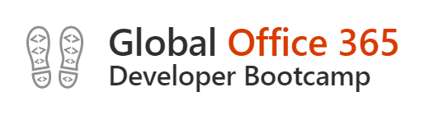
Wifi: Connection Instructions
• Make sure your wireless adapter is set to dynamically obtain an IP address • Connect to the wireless network MSFTGUEST • Open a browser and navigate to a web site to be redirected to the Captive Portal • Click on Event Attendee Code and enter the access code: msevent44ys

Slide 11
Download hands-on labs: https://github.com/andersdissing/OfficeBootcamp-2017-11-16

Slide 12
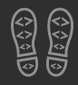
Enjoy the Bootcamp

